Slide 1
HTML
By ADEEM ALI ANWAR

Slide 2
HTML (Hyper Text Markup Language)
A markup language
Annotates text to add value
Uses defined tags with defined semantics

Slide 3
Document Structure
HTML Document comprises of elements
An element contains other elements
Everything is contained in HTML element
HTML element contains:
HEAD element: contains meta-information
BODY element: contains the actual content

Slide 4
Element Structure
Element comprises of:
Start Tag
End Tag
Attributes and values
Content
<tag attr1=”value1” attr2=”value2” ...> content... </tag>
<tag attr1=”value1” attr2=”value2” … />

Slide 5
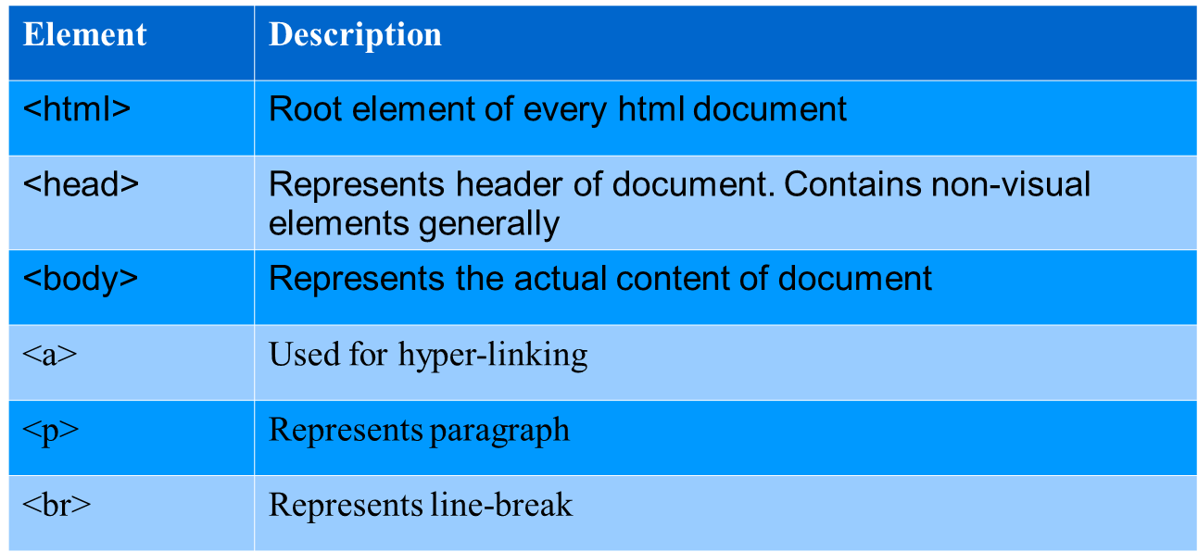
Basic Elements

Slide 6
Muhammad Iqbal
Sir Muhammad Iqbal (November 9, 1877 – April 21, 1938), also known as Allama Iqbal, was a philosopher, poet and politician[1] in British India who is widely regarded as having inspired the Pakistan Movement. He is considered one of the most important figures in Urdu literature,[2] with literary work in both the Urdu and Persian languages.[1][2]
Iqbal is admired as a prominent classical poet by Pakistani, Indian, Iranian, and other international scholars of literature.[3][4] Though Iqbal is best known as an eminent poet, he is also a highly acclaimed "Muslim philosophical thinker of modern times".[1][4] His first poetry book, Asrar-e-Khudi, appeared in the Persian language in 1915, and other books of poetry include Rumuz-i-Bekhudi, Payam-i-Mashriq and Zabur-i-Ajam. Amongst these his best known Urdu works are Bang-i-Dara, Bal-i-Jibril, Zarb-i Kalim and a part of Armughan-e-Hijaz.[5] In Iran and Afghanistan, he is famous as Iqbal-e Lahore (Iqbal of Lahore), and he is most appreciated for his Persian work.[6] Along with his Urdu and Persian poetry, his various Urdu and English lectures and letters have been very influential in cultural, social, religious and political disputes over the years

Slide 7
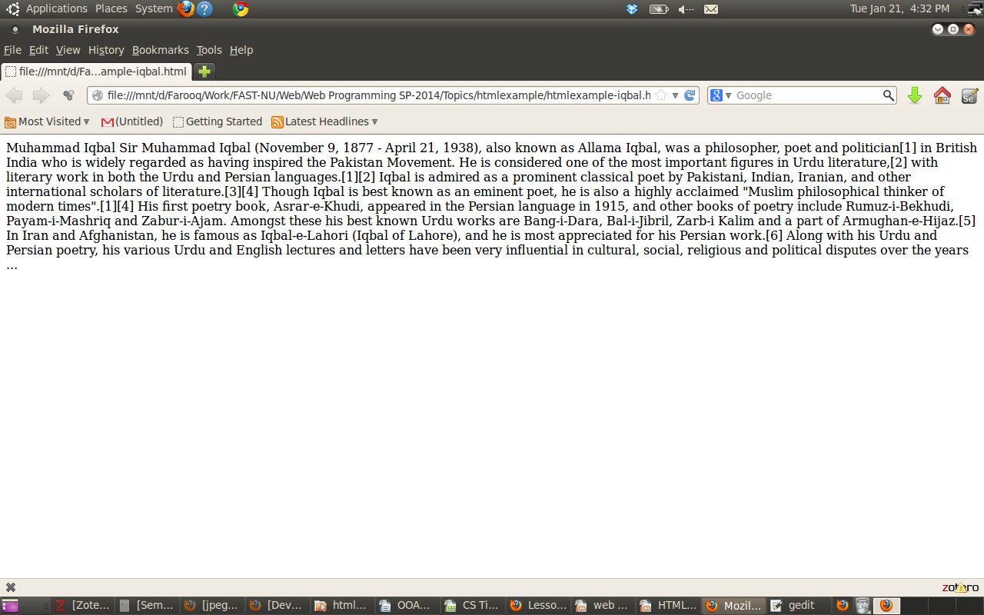

Slide 8
<html>
<body>
<h1>Muhammad Iqbal</h1>
<p>
Sir Muhammad Iqbal (November 9, 1877 - April 21, 1938), also known as Allama Iqbal, was a philosopher, poet and politician[1] in British India who is widely regarded as having inspired the Pakistan Movement. He is considered one of the most important figures in Urdu literature,[2] with literary work in both the Urdu and Persian languages.[1][2]
</p>
<p>
Iqbal is admired as a prominent classical poet by Pakistani, Indian, Iranian, and other international scholars of literature.[3][4] Though Iqbal is best known as an eminent poet, he is also a highly acclaimed "Muslim philosophical thinker of modern times".[1][4] His first poetry book, Asrar-e-Khudi, appeared in the Persian language in 1915, and other books of poetry include Rumuz-i-Bekhudi, Payam-i-Mashriq and Zabur-i-Ajam. Amongst these his best known Urdu works are Bang-i-Dara, Bal-i-Jibril, Zarb-i Kalim and a part of Armughan-e-Hijaz.[5] In Iran and Afghanistan, he is famous as Iqbal-e-Lahori (Iqbal of Lahore), and he is most appreciated for his Persian work.[6] Along with his Urdu and Persian poetry, his various Urdu and English lectures and letters have been very influential in cultural, social, religious and political disputes over the years
</p>
<p>...</p>
</body>
</html>

Slide 9
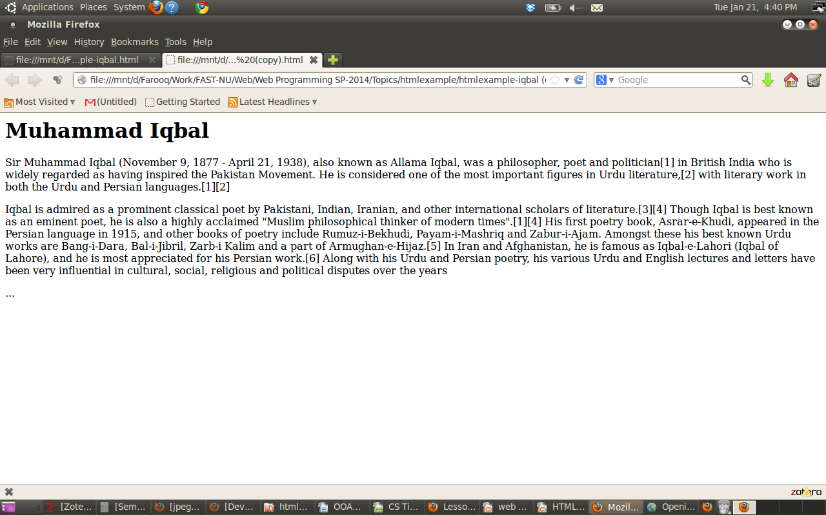

Slide 10
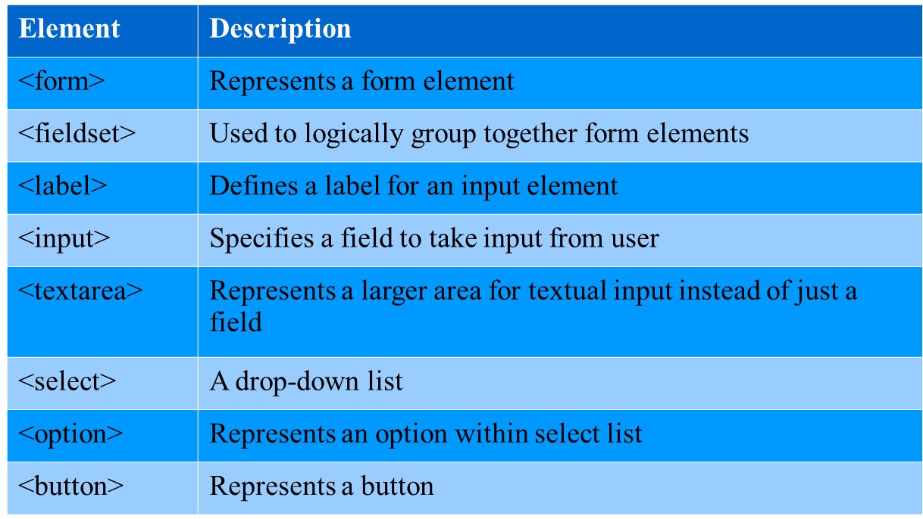
Form Elements

Slide 11
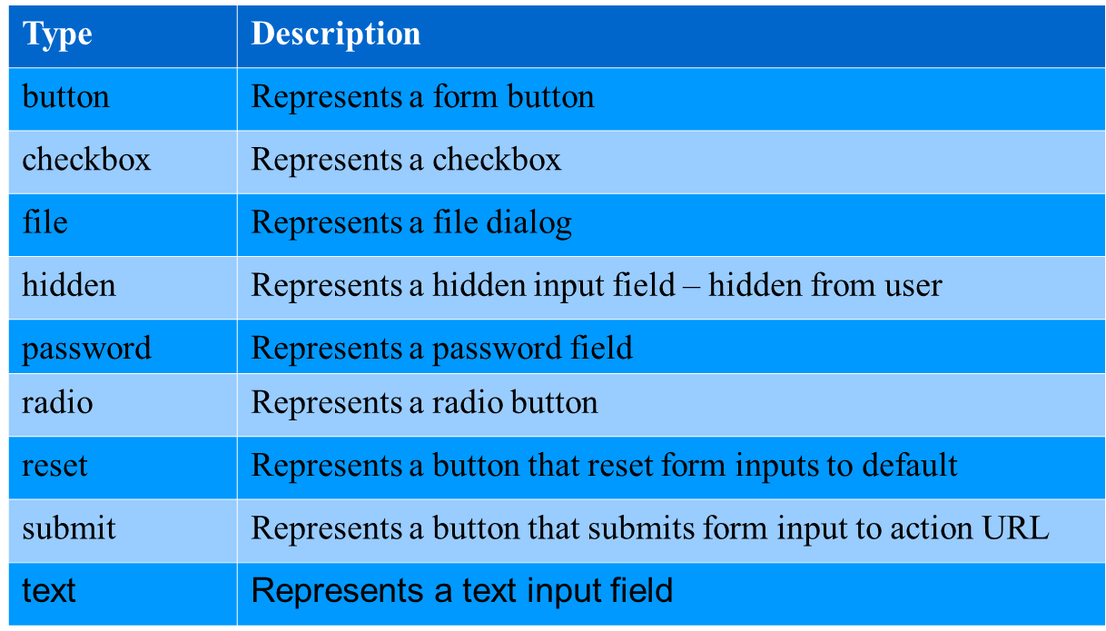
Types of Input

Slide 12
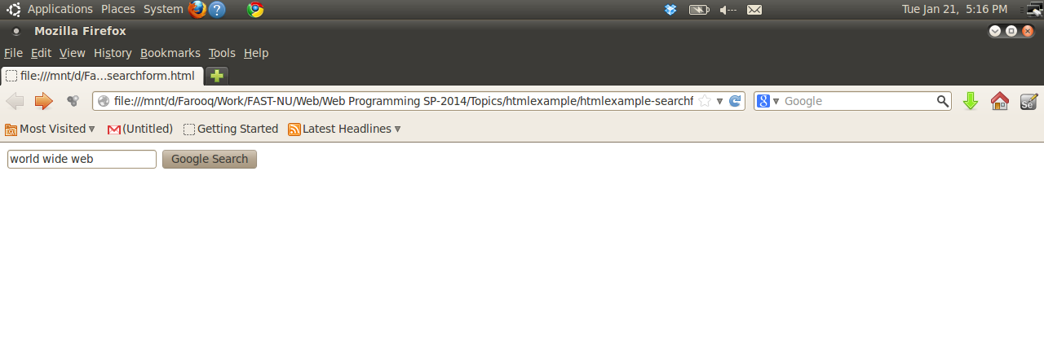
Request method
URL for form submission
<html>
<body>
<form method="GET" action="http://www.google.com/search">
<input type="text" name="q" />
<input type="submit" value="Google Search" />
</form>
</body>
</html>
Text field
Represents a button that will submit form on click

Slide 13
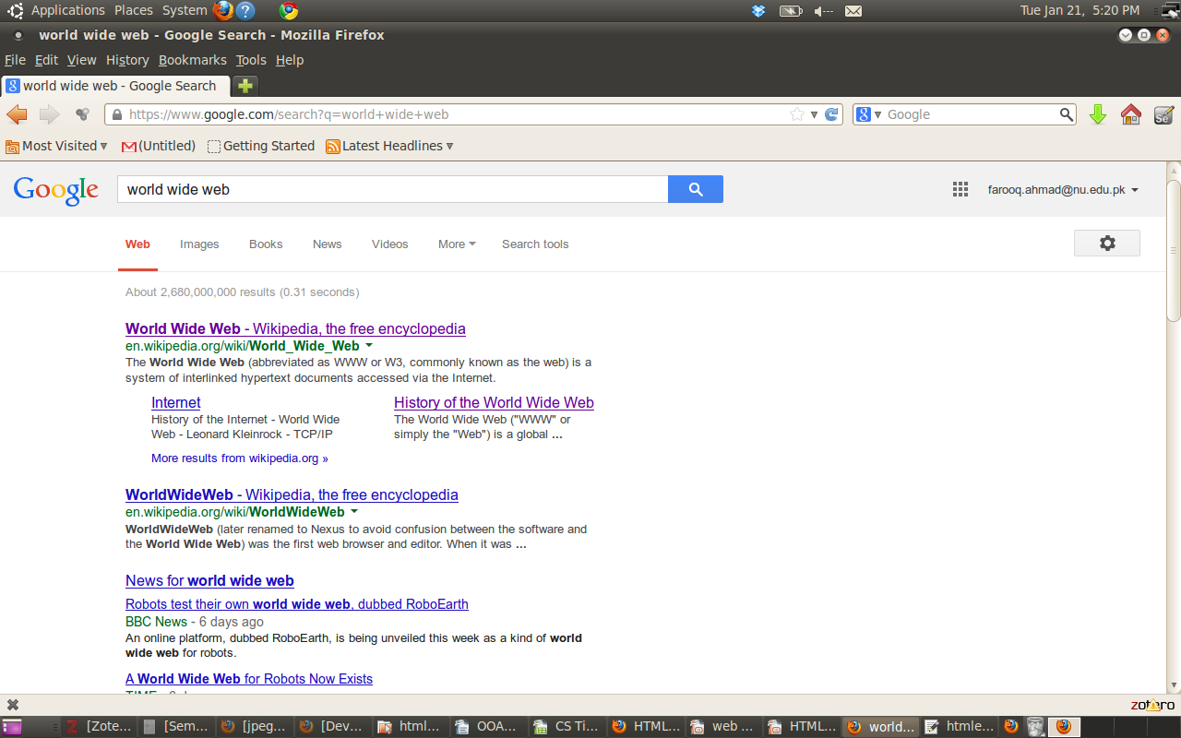
Form parameters are shown in browser bar

Slide 14
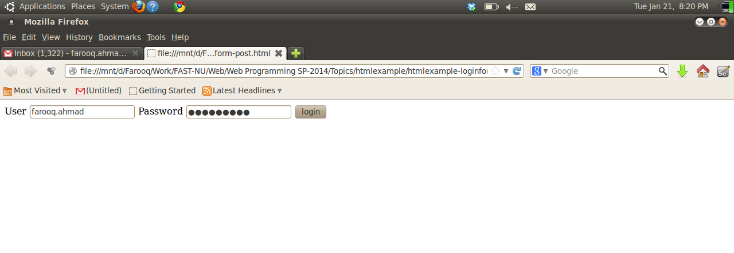
Request method
URL for form submission
<html>
<body>
<form method="POST" action="http://slate.nu.edu.pk/portal/xlogin">
User <input type="text" name="eid" />
Password <input type="password" name="pw" />
<input type="submit" value="login">
</form>
</body>
</html>
Text field
Password field

Slide 15
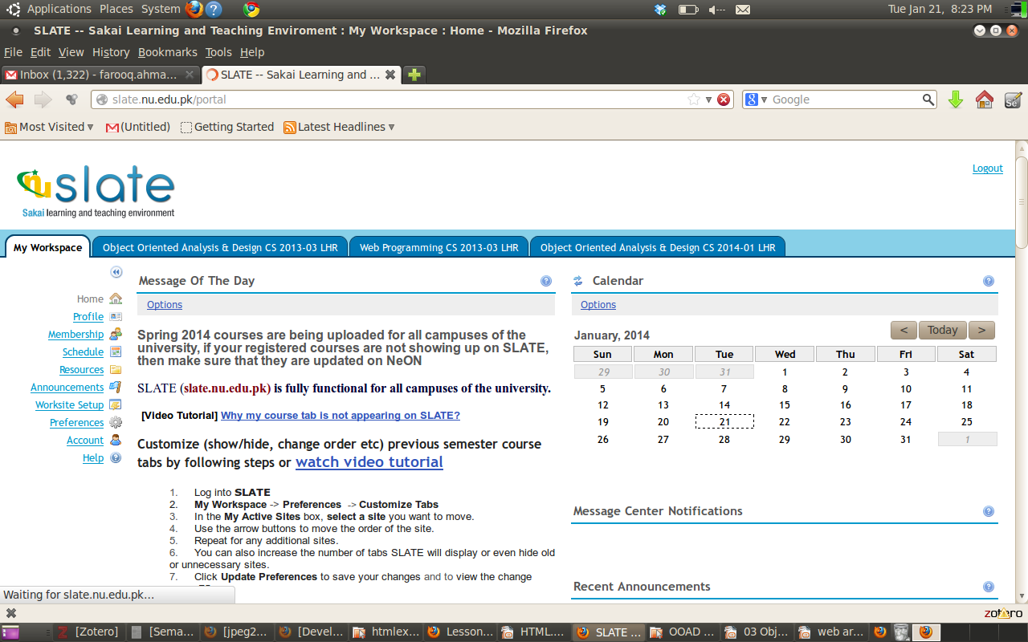
Form parameters not shown

Slide 16
GET vs POST
GET requests can be cached
GET requests remain in the browser history
GET requests can be bookmarked
GET requests have length restrictions
GET requests are to retrieve data
POST requests are never cached
POST requests do not remain in the browser history
POST requests cannot be bookmarked
POST requests have no restrictions on data length
POST requests should be used to transmit data

